Slide 1
MDS535 Programming Language and Environments: Apache Scala Spark
David A. Ostrowski

Slide 2


Resilient Distributed Dataset Spark : Programming with RDDs
RDDs are Spark’s core abstraction for working with Data
RDDs are Immutable Distributed Collections of Elements
In Spark , all work is expressed as either creating new RDDs , transforming existing RDDs or calling operations on RDDs to compute a result.
Spark automatically distributes the data contained in RDDs across your cluster and parallelizes the operations you perform on them

Slide 3
Resilient Distributed Dataset Spark : Programming with RDDs
Each RDD is split into multiple partitions which may be computed on different nodes of the cluster
Users create RDDs in two ways
Loading an external dataset
Distributing a collection of objects in their driver program.

Slide 4
Resilient Distributed Dataset Spark : Programming with RDDs
One can load a text file as an RDD of strings using SparkContext.textFile()
NOTE: data can be read in from a number of data sources including HDFS
NOTE: to read in the file as specified you need to be in the Spark home directory
scala> val file = sc.textFile("README.md")
Once created, RDDs offer two types of operations:
Transformations
Actions.
Transformations construct a new RDD from a previous one.

Slide 5
Resilient Distributed Dataset Spark : Programming with RDDs
The filter operation is supported by a function literal where ‘line’ is the paramter list and ‘line.contains(“and”)’ is the function body
scala> val c = file.filter(line => line.contains("and"))
The collect() method will dump the output to the screen
Scala>c.collect()

Slide 6
Resilient Distributed Dataset Spark : Programming with RDDs
Actions compute a result based on an RDD and either return it to the driver program or save it to an external storage system.
Actions force the evaluation of transformations required for the RDD they are called on, since they are required to actually produce output
count gives the number of output lines
scala> c.count()
The following will print out the lines
Scala>println(“input had “ + c.count() + “ lines”)
The take() method will retrieve ‘n’ numbers of the output record
Scala>c.take(10).foreach(println)

Slide 7
Resilient Distributed Dataset Spark : Programming with RDDs
We used take() to retrieve a small number of elements in the RDD at the driver program
We then iterate over them locally to print out information to the driver.
RDDs also have a collect() function to a very small size and you’d like to deal with it locally. Keep in mind that your entire dataset must fit into memory on a single machine to use collect() on it , so collect() shouldn’t be used on large datasets.

Slide 8
Resilient Distributed Dataset Spark : Programming with RDDs
Spark only computes RDDs in a lazy fashion, the first time they are used in an action.
This is for efficiency in terms of big data
computing only the data needed for its result.
Helps when dealing with extremely large files that may not be computed on the same node
In the case of using the ‘first’ method – it is only necessary to read in the very first line of a file, once again, supporting a more efficient operation.

Slide 9
Resilient Distributed Dataset Spark : Programming with RDDs
Spark’s RDDs are by default recomputed each time you run an action on them.
To reuse an RDD in multiple actions, you can ask Spark to persist it using RDD.persist().
We can ask Spark to persist our data in a number of different places.
After computing it the first time, Spark, will store the RDD contents in memory (partitioned across the machines in your cluster) and reuse them in future actions.

Slide 10
Resilient Distributed Dataset Spark : Programming with RDDs
To summarize, every Spark session will work as follows:
1) create some input RDDs from external data
2) Transform them to define new RDDs using transformations like filter()
3) Ask Spark to persist() any intermediate RDDs that will need to be reused
4) Launch actions such as count() and first() to kick off a parallel computation which is then optimized and executed by Spark

Slide 11
Resilient Distributed Dataset Spark : Programming with RDDs
Spark provides two ways to create RDDs, loading an external dataset and parallelizing a collection in your driver program
The simplest way to create RDDs is to take an existing in-memory collection and pass it to SparkContext’s parallelize method
NOTE: not widely used as it requires you to have your entire dataset in memory on one machine
Example:
val lines = sc.parallelize(List(“pandas”, “I like pandas”))

Slide 12
Resilient Distributed Dataset Spark : Programming with RDDs
Basic RDDs – the two most common transformations you will likely be performing on basic RDDs are map and filter.
The map transformation takes in a function and applies it to each element in the RDD with the result of the function being the new value of each element in the resulting RDD.
The filter transformation take in a function and returns an RDD which only has elements that pass the filter function.

Slide 13
Resilient Distributed Dataset Spark : Programming with RDDs
We can use map to do any number of things from fetching the website associated with each URL in our collection, to just squaring the numbers.
With Scala and python you can use the standard anonymous function notation or pass in a function
scala>val input =sc.parallelize(List(1,2,3,4))
scala>val result = input.map(x => x * x )
scala>println(result.collect().mkString(“,”))

Slide 14
Resilient Distributed Dataset Spark : Programming with RDDs
RDDs use key-value pairs which is a common data type required for many operations in Spark
Key-Value RDDs are commonly used to perform aggregations and often we will do some initial ETL to get our data into a key-value format.
Key-value RDDs expose new operations, grouping together data with the same key, and grouping together two different RDDs.

Slide 15
Resilient Distributed Dataset Spark : Programming with RDDs
An advanced feature that lets users control the layout of Pair RDDs across nodes: partitioning.
Using controllable partitioning, applications can sometimes greatly reduce communication costs, by ensuring data that will be accessed together and will be on the same node.

Slide 16
Resilient Distributed Dataset Spark : Programming with RDDs
combineByKey (createCombiner, mergeValue, mergeCombiners, partitioner) purpose: combine values with the same key together
groupByKey() group together values with the same key
ReduceByKey(func) combine values with the same key together
mapValues : apply a function to each value of a pari RDD without changing the key
flatmapValues(func) Apply a function which returns an iterator to each value of a Pair RDD and for each element returned produce a key-value entry with the old key

Slide 17
Resilient Distributed Dataset Spark : Programming with RDDs
Keys() return an RDD of just the keys
Values() return an RDD of just the values
sortByKey() reutrns an RDD sorted by the key
subtractByKey () remove elemetns with a key present in the other RDD
Jion() perform an inner join between two RDDs
rightOuterJoin Perform a join between two RDDs where they key must be present in the other RDD
leftOuterJoin Perform a join between two RDDs where the key must be present in the other RDD
Cogroup – Group back together data from both RDDs sharing the same key

Slide 18
RDD example (PI Estimation)
scala>var NUM_SAMPLES=5
scala> val count = sc.parallelize(1 to NUM_SAMPLES).map{i =>
| val x = Math.random()
| val y = Math.random()
| if (x*x + y*y < 1) 1 else 0
| }.reduce(_ + _)
scala>println("Pi is roughly " + 4.0 * count / NUM_SAMPLES)

Slide 19
(estimation of PI ,by “throwing darts” at a circle) random points in the unit square (0,0) to (1,1). The fraction that fall into the circle should be PI / 4.
RDD example (PI Estimation)
.9 * .9 = .81
.81 + .81 = 1.62
Outside the circle
.5 * .5 = .25
.25 + .25 = .5
Inside the circle

Slide 20
RDD example
(PI Estimation)
// create RDD will start with [1,2,3…NUM_SAMPLES]
// start with an RDD containing a list of 1…Numsamples
scala> val count = sc.parallelize(1 to NUM_SAMPLES).
map{i =>
| val x = Math.random()
| val y = Math.random()
| if (x*x + y*y < 1) 1 else 0
| }.reduce(_ + _)

Slide 21
RDD example
(PI Estimation)
//NOTE: I can run the creation of RDD by itself to demonstrate the usage
scala> val count = sc.parallelize(1 to NUM_SAMPLES)
res24: Array[Int] = Array(1, 2, 3, 4, 5)
// NOTE: I can also demonstrate how the map works
scala> val count = sc.parallelize(1 to NUM_SAMPLES).map{i => 0}
res0: Array[Int] = Array(0, 0, 0, 0, 0)

Slide 22
RDD example
(PI Estimation)
//Map a series of evaluated points //between [0,0] and [1,1] to the RDD
// below me create values of x and y between 0 and 1
// the metric in the “if” statement considers if you are in the circle or not.
scala>var NUM_SAMPLES=5
scala> val count = sc.parallelize(1 to NUM_SAMPLES).map{i =>
| val x = Math.random()
| val y = Math.random()
| if (x*x + y*y < 1) 1 else 0
| }.reduce(_ + _)

Slide 23
RDD example
(PI Estimation)
Running with small example sizes can produce inaccurate output
Scala>var NUM_SAMPLES=5
scala> val count = sc.parallelize(1 to NUM_SAMPLES).map{i =>
| val x = Math.random()
| val y = Math.random()
| if (x*x + y*y < 1) 1 else 0
| }
// possible output would be (where 0 indicates outside of the circle and 1 indicating inside the circle)
res0: Array[Int] = Array(0, 1, 1, 0, 1)

Slide 24
RDD example
(PI Estimation)
scala> val count = sc.parallelize(1 to NUM_SAMPLES).map{i =>
| val x = Math.random()
| val y = Math.random()
| if (x*x + y*y < 1) 1 else 0
| }.reduce(_ + _)
The ‘reduce’ here would sum everything in the array.
Finally the following calculation will produce the PI estimate
println("Pi is roughly " + 4.0 * count / NUM_SAMPLES)

Slide 25
Spark SQL
Spark SQL is Spark’s interface for working with structured and semi-structured data.
Structured data is any data that has a schema, that is, a known set of fields for each record.
Spark SQL makes it both easier and more efficient to load and query.

Slide 26
Spark SQL
Spark SQL provides three main capabilities:
1)It can load data from a variety of structured sources e.g. JSON, Hive and Parquet
2) It lets you query the data using SQL, both inside a Spark program and from external tools that connect to a Spark SQL through standard database connectors
3) Spark SQL provides a rich integration between SQL and regular python/ java/ scala code, including the ability to join RDDs and SQL tables, expose custom functions in SQL

Slide 27
Spark SQL
Spark SQL provides a special type of RDD called SchemaRDD.
A schemaRDD is an RDD of row objects, each representing a record.
SchemaRDD also knows the schema of its rows.
While SchemaRDDs look like regular RDDs internally they store data in a more efficient manner, taking advantage of their schema.

Slide 28
Spark SQL
The most powerful way to use Spark SQL is inside a Spark application. This gives the power to easily load data and query it with SQL while simultaneously combining it with ‘regular’ program code in Python, Java or Scala.
To use Spark SQL this way, we construct a HiveContext (or SQLContext for those wanting a stripped down version) based on our SparkContext

Slide 29
Spark SQL
The Spark SQL context provides functions for querying and interacting with Spark SQL data
Using the HiveContext, we can build SchemaRDDs, which represent our structure data and operate on them with SQL or with normal RDD operations like map

Slide 30
Spark SQL
To begin with a Spark SQL we add a few imports
Import org.apache.spark.sql.hive.HiveContext
Import org.apache.spark.sql.SparkContext
NOTE: with Scala, we do not import HiveContext._, like with SparkContext, to get access to implicits.
These implicits are used to convert RDDs with the required type information into Spark SQLs specialized RDDs for querying. Instead once we have constructed an instance of the HiveContext, we can then import that implicits by adding

Slide 31
Spark SQL
Spark SQL (datafile input)
mark, 21
mike, 40
sam,16
mary,50

Slide 32
Spark SQL
rdd
dataframe
datastore
import org.apache.spark.SparkFiles
val sqlContext = new org.apache.spark.sql.SQLContext(sc) import sqlContext.createSchemaRDD
case class Person(name: String, age: Int)
val people = sc.textFile("examples/src/main/resources/people.txt").map(_.split(",")).map(p => Person(p(0), p(1).trim.toInt))
people.toDF().registerTempTable("people")
val teenagers = sqlContext.sql("SELECT name FROM people WHERE age >= 13 AND age <= 19")
teenagers.map(t => "Name: " + t(0)).collect().foreach(println)

Slide 33
Spark SQL (breakdown 1/2)
import org.apache.spark.SparkFiles
val sqlContext = new org.apache.spark.sql.SQLContext(sc)
// createSchemaRDD is used to implicitly convert an RDD to a SchemaRDD.
import sqlContext.createSchemaRDD
// Define the schema using a case class.
// Note: Case classes in Scala 2.10 can support only up to 22 fields. To work around this limit,
// you can use custom classes that implement the Product interface.
case class Person(name: String, age: Int)

Slide 34
Spark SQL (breakdown part 2/2)
// Create an RDD of Person objects and register it as a table.
val people = sc.textFile("examples/src/main/resources/people.txt").map(_.split(",")).map(p => Person(p(0), p(1).trim.toInt))
people.registerTempTable("people")
// SQL statements can be run by using the sql methods provided by sqlContext.
val teenagers = sqlContext.sql("SELECT name FROM people WHERE age >= 13 AND age <= 19")
// The results of SQL queries are SchemaRDDs and support all the normal RDD operations.
// The columns of a row in the result can be accessed by ordinal.
teenagers.map(t => "Name: " + t(0)).collect().foreach(println)

Slide 35
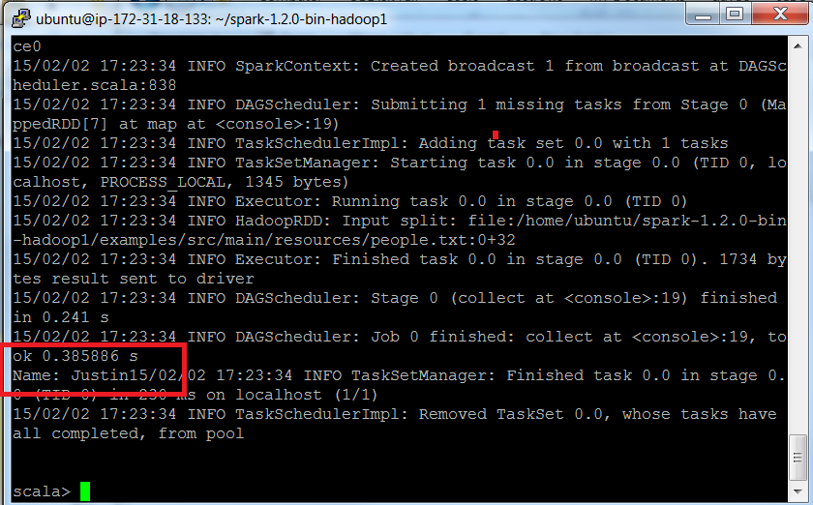
Spark SQL output

Slide 36
Spark SQL
SchemaRDDs are also regular RDDs, so you can operate on them using existing RDD transformations like map and filter.
They provide several additional capabilities.
Most importantly, you can register any SchemaRDD as a temporary table to query it via HiveContext. sql or SQLContext.sql.
This is done using the SchemaRDD’s register tempTable method as in our example above.

Slide 37
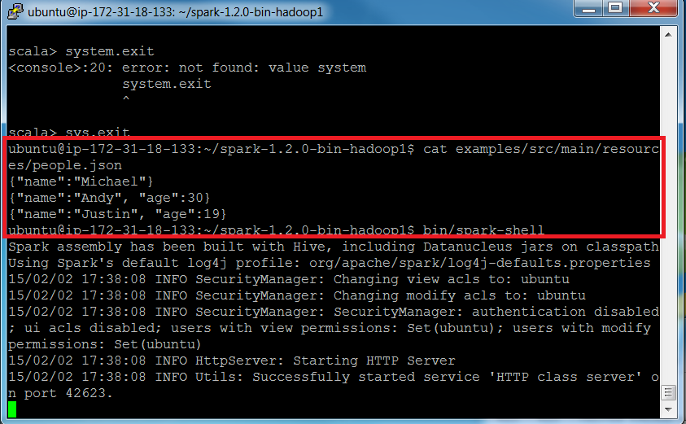
Spark SQL (breakdown part 2/2)

Slide 38
Spark SQL json Example
import org.apache.spark.SparkFiles
// createSchemaRDD is used to implicitly convert an RDD to a SchemaRDD.
import sqlContext.createSchemaRDD
val sqlContext = new org.apache.spark.sql.SQLContext(sc)
// A JSON dataset is pointed to by path.
// The path can be either a single text file or a directory storing text files.
val path = "examples/src/main/resources/people.json"
// Create a SchemaRDD from the file(s) pointed to by path
val people = sqlContext.jsonFile(path)

Slide 39
Spark SQL json Example
// The inferred schema can be visualized using the printSchema() method.
people.printSchema()
// root
// |-- age: IntegerType
// |-- name: StringType
// Register this SchemaRDD as a table.
people.toDF().registerTempTable("people")
// SQL statements can be run by using the sql methods provided by sqlContext.
val teenagers = sqlContext.sql("SELECT name FROM people WHERE age >= 13 AND age <= 19")
// Alternatively, a SchemaRDD can be created for a JSON dataset represented by
// an RDD[String] storing one JSON object per string.
val anotherPeopleRDD = sc.parallelize(
"""{"name":"Yin","address":{"city":"Columbus","state":"Ohio"}}""" :: Nil)
val anotherPeople = sqlContext.jsonRDD(anotherPeopleRDD)

Slide 40
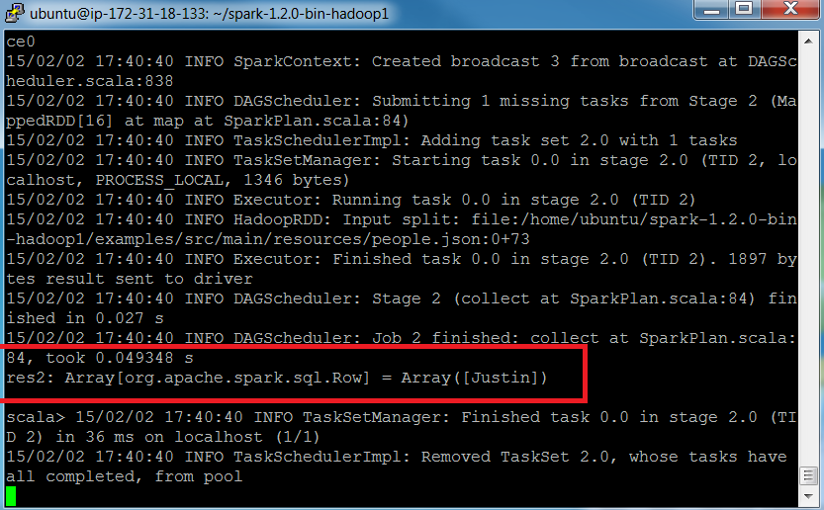
Spark SQL (breakdown part 2/2)

